Slide 1
Chapter 7 MEMORY ORGANIZATION

Slide 2
Contents:
Memory Hierarchy
Associative Memory
Cache Memory: Cache Mapping techniques
Replacing data in cache, writing data to the cache, cache performance basics

Slide 3
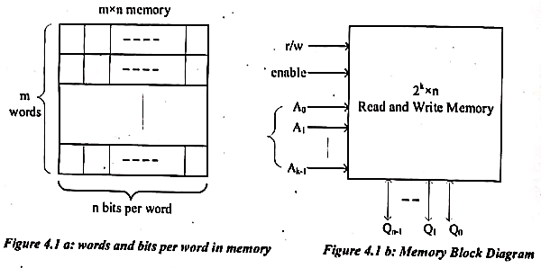
7.1 Memory
A memory stores large number of items commonly referred as words.
Each word consists of a specific number of bits, for e.g. 8 bits.
Therefore, a memory can be viewed as:
m words of n bits
each for a total of m x n bits
Figure: Words and bits per word
in memory
Figure: Memory Block diagram

Slide 4
If a memory has k address inputs, it can have up to 2^{k} words (m=2^{k}) which implies that; k=log₂(m).
This means that log₂(m) address input signals are required to identify a particular word.
Also, n data signals are required to output a selected word.
For example:
4096 x 8 memory:
can store 32768 bits and
require 12 address signals ( i.e k= log₂(4096) = 12 )
eight I/O data signals.

Slide 5
7.2 Memory Hierarchy
There are three key characteristics of memory that can put them in a hierarchical order, namely: capacity, access time, and cost.
The below relationship holds true for the memories:
Faster the access time, the greater is the cost per bit
Greater the storage capacity, smaller the cost per bit
Greater storage capacity, slower access time

Slide 6
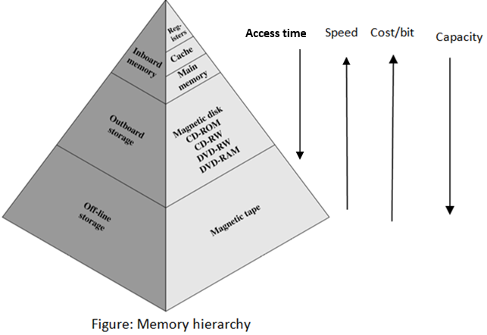
To meet performance requirements, the ES designer wishes to use expensive, relatively lower-capacity memories with short access times.
But ultimately, the cost increases.
So, the designer should employ a memory hierarchy.

Slide 7
As one goes down the hierarchy, the following occur:
Decreasing cost per bit
Increasing capacity
Increasing access time
Decreasing frequency of access of the memory by the processor

Slide 8
7.2 Associative Memory
Aka Content Addressable Memory (CAM)
A memory unit accessed by content, rather than by address, is called CAM.
When a write operation is performed on associative memory, no address or memory location is given to the word.
The memory itself is capable of finding an empty unused location to store the word.
For read operation, the content of the word, or part of the word, is specified.
The words which match the specified content are located by the memory and are marked for reading.

Slide 9
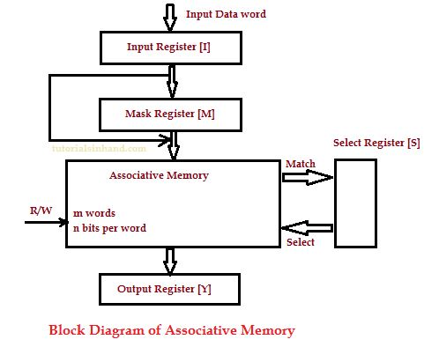
Block diagram of CAM
Input Register (I):
hold the data that is to be written into the associative memory.
It is also used to hold the data that is to be searched for.
At a particular time it can hold a data containing one word of length (say n).
Mask Register (M)
is used to provide a mask for choosing a key or particular field in the input register's word.
Since input register can hold a data of one word of length n so the maximum length of mask register can be n.
Select Register (S)
contains m bits, one for each memory words.
When input data in I register is compared to key in m register and match is found then that particular bit is set in select register.
Output Register (Y)
contains the matched data word that is retrieved from associative memory.

Slide 10
Working of CAM
The words which are kept in the memory are compared in parallel with the content of the Input Register.
The Mask register (M) provides a mask for choosing a particular field or key in the Input word.
If the Mask Register contains a binary value of all 1's, then the entire argument is compared with each memory word.
Otherwise, only those bits in the Input that have 1's in their corresponding position of the Mask register are compared.

Slide 11
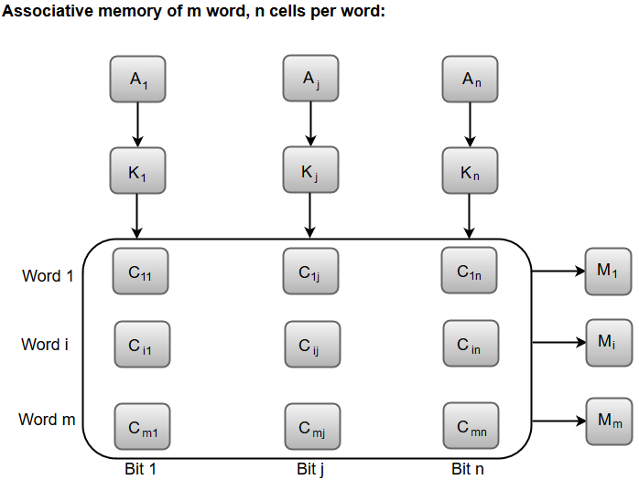
The cells present inside the memory array are marked by the letter C with two subscripts.
The first subscript gives the word number and the second specifies the bit position in the word.
For instance, the cell C_{ij} is the cell for bit j in word i.
A bit I_{j} in the Input register is compared with all the bits in column j of the array provided that M_{j} = 1.
This process is done for all columns j = 1, 2, 3......, n.
If a match occurs between all the unmasked bits of the Input and the bits in word i, the corresponding bit S_{i} in the match register is set to 1.
If one or more unmasked bits of the Input and the word do not match, S_{i} is cleared to 0.
I₁
I_{j}
I_{n}
M₁
M_{j}
M_{n}
S₁
S_{i}
S_{m}
More study: https://www.youtube.com/watch?v=SV7Kk1njt5c

Slide 12
The associative memory searches all of its locations in parallel and marks the locations that match the specified data input. The matching data values are then read out sequentially.
Cache memory is constructed using either static RAM or associative memory, depending on mapping scheme used.
SRAM receives an address and access the data at that address.
An associative memory is more expensive than a RAM because each cell must have storage capability as well as logic circuit for matching its contents with an external argument.
For this reason, associative memories are used in application where search time is very critical and short.

Slide 13
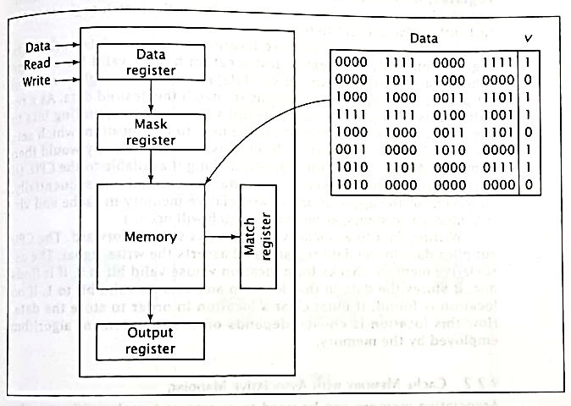
Cache memory is
Note: This is book’s diagram.
Please refer book.
Fig: Internal organization of Associative memory

Slide 14
7.3 Cache
Cache memory is a small-sized type of volatile computer memory that provides high-speed data access to a processor and stores frequently used computer programs, applications and data.
It is the fastest memory in a computer, and is typically integrated onto the motherboard and directly embedded in the processor or main random-access memory (RAM).
Cache is usually designed using static RAM rather than dynamic RAM, which is one reason that cache is more expensive but faster than main memory.
When the processor attempts to read a word of memory, a check is made to determine if the word is in the cache.
If so, the word is delivered to the processor (ie. Cache Hit).
If not (ie. Cache Miss), a block of main memory, consisting of fixed number of words is read into the cache and then the word is delivered to the processor.

Slide 15
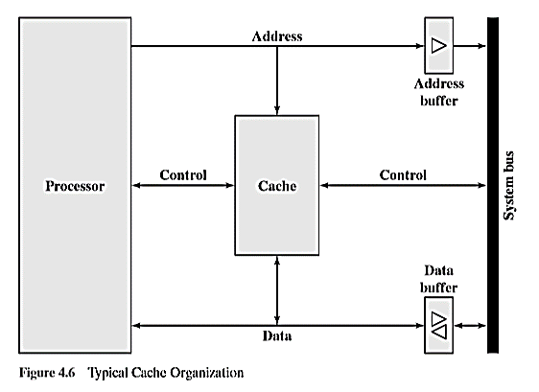
Cache connects to the processor via data control and address line.
The data and address lines also attached to data and address buffer which attached to a system bus from which main memory is reached.
When a cache hit occurs, the data and address buffers are disabled and the communication is only between processor and cache with no system bus traffic.
When a cache miss occurs, the desired word is first read into the cache and then transferred from cache to processor. For later case, the cache is physically interposed between the processor and main memory for all data, address and control lines.

Slide 16
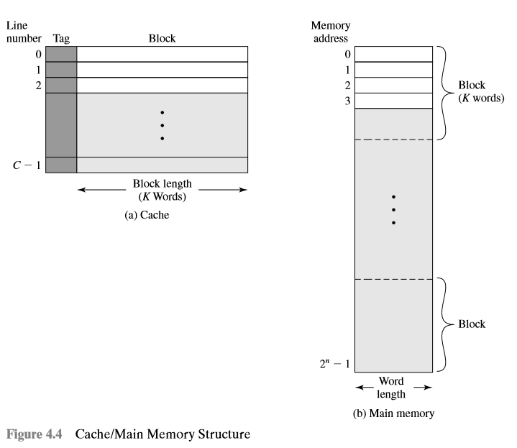
Structure of Cache and Main memory:
Memory is represented as m x n.
Where m is no of words, and n is no of bits in each word.
Memory consists of fixed length word size.
Address lines = log₂(m)
Group of words is called a block.
Each block consists of K words, each being fixed length.
No of blocks i.e. B = m/K blocks.
Cache consists of C lines of K words each.
Each line contains K words, plus a tag of a few bits.
The tag is usually a portion of the main memory address.
The number of lines (C) of cache is less than the number of main memory blocks (B).
m-1

Slide 17
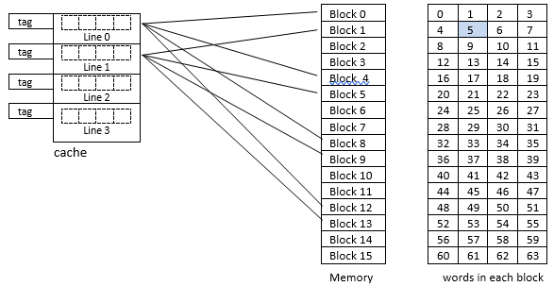
Example:
Consider a 64x8 memory
Here, No of words (m) = 64
and n is no of bits in each word (n) = 8
Address lines = log₂(64) = 5
Here, block size = 4
No of block = 64/4 = 16
Consider a cache of 4 lines
Each line contains 4 words, plus a tag

Slide 18
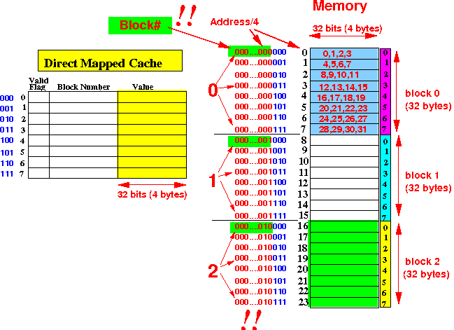

Slide 19
7.3 Cache Mapping Techniques:
The transformation of data from main memory to cache memory is referred to as memory mapping process.
Because there are fewer cache lines than main memory blocks, an algorithm is needed for mapping main memory blocks into cache lines.
There are three different types of mapping functions in common use and are:
direct, associative and set associative.

Slide 20
1. Direct Mapping
It is the simplest mapping technique.
It maps certain block of main memory into only one possible cache line, i.e. a given main memory block can be placed in one and only one place on cache.
It implements one-to-many function, i.e., one cache line can map many blocks of memory.
The cache line no can be calculated as:
i = j MOD m
Where, i = cache line number;
j = main memory block number;
m = number of lines in the cache
For e.g., if there are 16 blocks of main memory and 4 cache lines, and if we need to identify which cache line maps the block no 14 of the main memory.
Here, i = 14 MOD 4 =2
So, the block no 14 of the main memory is mapped by cache line no 2.
Here, memory consists of 16 blocks of each containing 4 words in an array (say Block 0 has words 0,1,2,3 and Block 1 has 4,5,6,7….Block 15 has 60,61,62,63).
Similarly, each cache line maps 4 blocks of memory.
Fig: Direct Cache Mapping

Slide 21

1. Direct Mapping (Contd.)
Each physical address generated by the CPU is viewed as three fields:
For eg, if CPU generates a 6 bit address 000101, it is viewed as:
This tells to look at cache line no 1 tagged as 00 at its second index if desired address is present.
So, a 2-bit tag is enough to identify the block of memory in this case.
If the search is matched, this is a cache hit. But if the search does not match, then it is a miss.
Advantage: easy to implement
Disadvantage: not flexible, contention problem
Cache tag bits | Cache line no | Word
Fig: Direct Cache Mapping
Contention is what happens when demand for a shared resource exceeds the supply

Slide 22
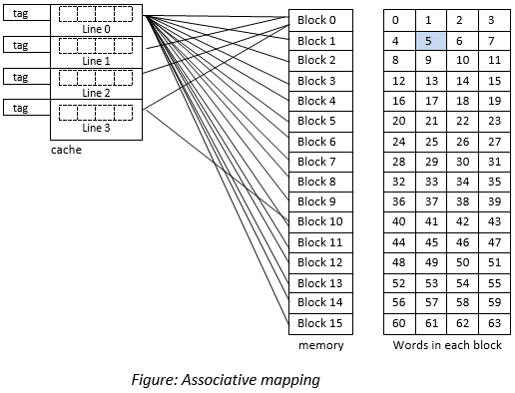


2. Associative Mapping
This is a much more flexible mapping technique.
Any main memory block can be loaded to any cache line position.
It implements many-to-many function.
Advantage: flexibility
Disadvantage: increased hardware cost, increased access time
Each physical address generated by the CPU is viewed as two fields:
For eg, if CPU generates a 6-bit address 000101, it is viewed as:
This tells to look at cache line tagged as 0001 if it contains the word 01 of the block 0001 of the main memory.
In this case, a 4-bit tags are required to identify those 16 blocks of main memory. The tag no represents the block no of the main memory.
Here, we need to search for all the 16 tags from 0000 to 1111 to determine whether a given block is in the cache or not.
Therefore, the cost of implementation of hardware (i.e comparator) will be higher.
The figure below represents the associative mapping:
Reference: https://www.youtube.com/watch?v=uwnsMaH-iV0

Slide 23
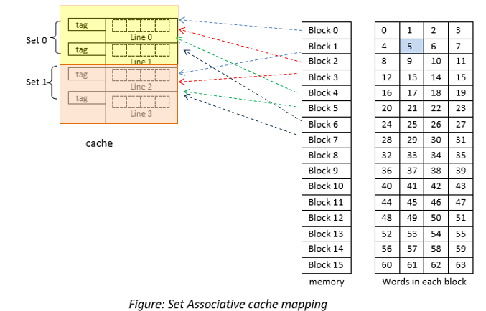
3. Set-associative Mapping
This is the combination of the direct and associative technique. Overcomes the limitation of contention and increased hardware cost.
In this case, lines of the cache are grouped into sets and the mapping allows to reside in any block of a particular set.
It implements many-to-many function.
The cache set no can be calculated as:
k = p MOD q
Where, k = set number
p = main memory block number;
q = number of sets in the cache
For e.g., if there are 16 blocks of main memory and 2 sets in cache, and if we need to identify which cache set maps the block no 14 of the main memory.
Here, k = 14 MOD 2 =0
So, the block no 14 of the main memory is mapped by cache set no 0.
Hence, Block 0,2,4,6,8,10,12,14 is mapped to set no 0.
Other block are mapped to set 1
Reference: https://www.youtube.com/watch?v=KhAh6thw_TI

Slide 24
3. Set-associative Mapping (Contd.)
Each physical address generated by the CPU is viewed as three fields:
For e.g., if CPU generates a 6-bit address 000101, it is viewed as:
This tells to look at cache line tagged as 000 and set 1 if it contains the word 01 of the block 0000 of the main memory.
First, it compares set no 1 if it is present in SET 0 (i.e from 00 and 01), and then looks for tag no 000 and finally looks for the index 2 of the cache line 1.
In this case, a 3-bit tags are required to identify those 8 blocks of main memory. The tag no represents the block no of the main memory.
Tag no | Set No | Word
000 | 1 | 01
Reference: https://www.youtube.com/watch?v=KhAh6thw_TI

Slide 25
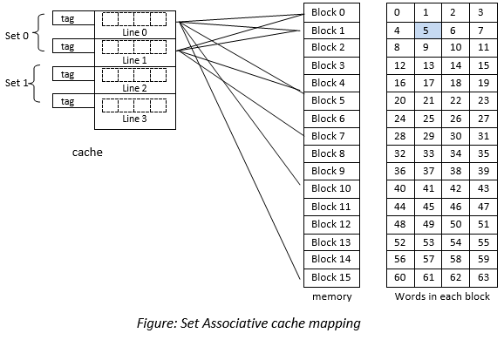

Slide 26
7.4 Cache Replacement Policy:
The cache replacement policy is the technique for choosing which cache block to replace when Full Associative cache is full, or when a Set-associative cache’s line is full.
It is to be noted that there is no choice in a direct-mapped cache; a main memory address always maps to the same cache address and thus replaces whatever block is already there.
There are three common replacement policies:
Random
Least Recently Used
First In First Out

Slide 27
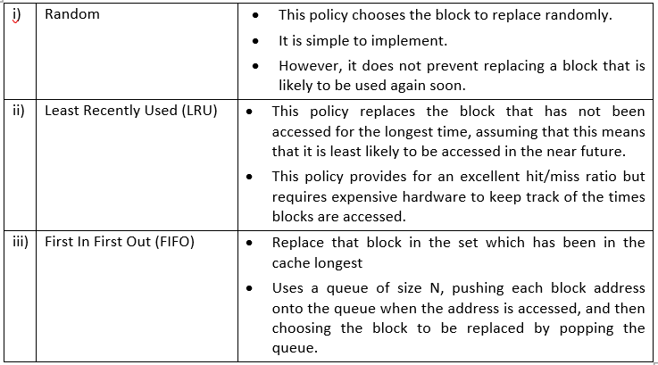

Slide 28
Cache Writing technique/policy:
Cache is a technique of storing a copy of data temporarily in rapidly accessible storage memory.
Cache stores most recently used words in small memory to increase the speed at which data is accessed.
It acts as a buffer between RAM and CPU and thus increases the speed at which data is available to the processor.

Slide 29
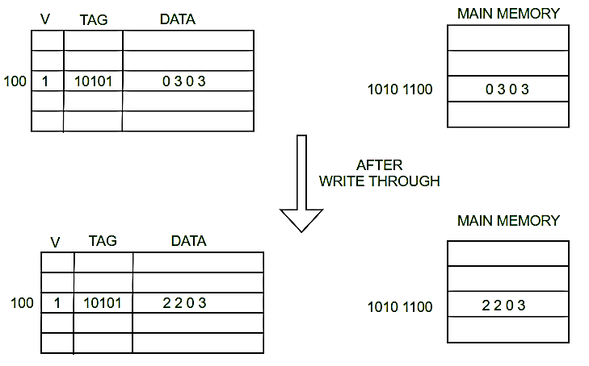
a) Write Through
In write-through, data is simultaneously updated to cache and memory.
This process is simpler and more reliable, keeps the cache and memory consistent.
This is used when there are no frequent writes to the cache (The number of write operations is less).
A Write-through cache colves the inconsistency problem by forcing all writes to update both the cache and the main memory.
Main issues: Badwidth
Reference: https://www.youtube.com/watch?v=uM8K0Z5usu8

Slide 30
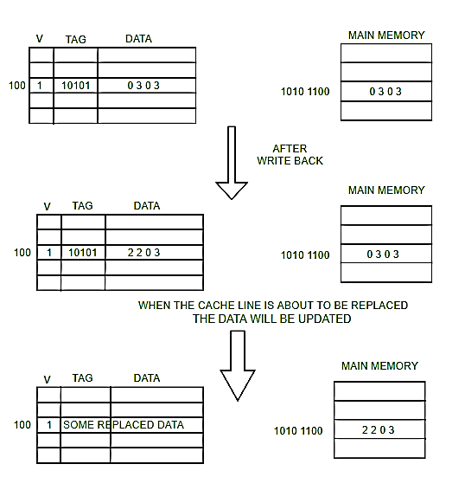
b) Write Back:
In this policy, the memory is not updated until the cache block needs to be replaced.
The data is updated only in the cache and updated into the memory at a later time.
Data is updated in the memory only when the cache line is ready to be replaced .
The modified cache content will be first be written to the main memory.
Only then can the cache lie be replaced with new data.

Slide 31
Exam Questions:
What is cache performance? Describe in brief the strategies used to write data to the cache memory. [PU 2017 Fall]
What is memory hierarchy? Differentiate between different types of cache mapping. [PU 2017 Spring]
What is Memory hierarchy? Describe the significance of Cache [PU 2018 Fall]
What is cache memory? Briefly explain Direct and Set-associative mapping. [PU 2019 Spring]
What is cache memory? Explain associative, set associative and direct mapping in cache. [PU 2020 Spring]

Slide 32
End of Chapter

